Slide 1
Overall
Introduction(ES)
Written by Ted.Jung
jongnag@gmail.com

Slide 2


Story
App
App
App
system
system
App
system
How?
Combine objects
Line-up processes simply
Operate Proactively

Slide 3
Story
Raw data
processes
Meaning
Data
File Logs
System usages
process
process
process
Which Data need to be collected?
How?
Make a schema on DB
Table with many attributes
Normalization
Insert
Many Select Queries
HTML with business logic
Changes (just add a new single attribute)

Slide 4
No options to improve?
few conditions
to get data
collect
scaling
redandancy
schemeless
echo
plugin
UI
note

Slide 5








Open source solutions
Raw
data
Data pipeline flows
Interactive
Graphical
User Interface
Analyzed &
Summarized
Data
Time flows

Slide 6
Current Image
What types of data?
Traditional, 3-Tiers application
Web (Nginx, Haproxy, Apache)
Was (Tomcat)
DB (MySQL, Redis, etc)
&
System (H/W-CPU, Memory, Disk, Network, Temperator, Fan)
Q) How to collect with which tool?
datas of which shape of format?
Q) How to store data to where?
Q) How to presents it? (just text or graphically by interaction)
Concerns?

Slide 7
Portal v.s Enterprise Svc
Dynamic | Static
Flexible | Fixed
Results with a single keyword | Conditions

Slide 8
Traditional Processes
(strict, not flexible)
Analysis
Data type
Normalization
Table
Database
Table
MVC
Business logic
OR mapper
View
(x)
Requirement (new view points)

Slide 9
Another approach to replace the traditional to new way differently
(flexible, dynamic)
Agents placing
(file location)
Schemeless but structured flexible
Analyzer ( filters -> tokenizer -> token filter)
Just a view point
Make a query if it is required
Layering components to set data Pipeline
Templating for UI
New view points
Add a few filters
in a configuration file

Slide 10
Dive Into (index)
Elasticsearch data storage
Analogy
Relational DB | Elasticsearch
Databases | Indeces
Tables | Types
Rows | Documents
Columns | Fields
Schema | Mapping
Index | Everything is indexed
SQL | Query DSL
RDBMS Row Data .vs Search Index
Index
DB
document
Table
Type
Here is some changes
Do not align more the type of ES to table of RDB
conceptually, it had the same concept, but, exactly those two items are not the same.
It will be removed from Next Version

Slide 11
Dive Into (sharding)
The act of storing data in Elasticsearch is called indexing.
In Elasticsearch, a document belongs to a type, and those types live inside an index.
An index is just a logical namespace that points to one or more physical shards.
Documents are stored and indexed in shards, but our applications don’t talk to them directly.
Instead, they talk to an index.
Shards are allocated to nodes in your cluster. As your cluster grows or shrinks,
It will be automatically migrated to shards between nodes by Elasticsearch
so that the cluster remains balanced.
Each shard has 0 or more replicas. A shard can be either a primary shard or a replica shard.
( A replica shard == just a copy of a primary shard.)
Each document in index belongs to a single primary shard. While there is no theoretical limit to the amount of data that a primary shard can hold, there is a practical limit based on hardware etc.
Index
Shard
Sub divided
index
Index
(lucene)
Segments
Type: logical categoryb
Type: logical categoryb
Index
(es)
Type: logical categoryb
Document
Document
Shard
Sub divided
index
Index
(lucene)
Segments

Slide 12
Elasticsearch Cluster
Elasticsearch Cluster
A group of nodes with the same cluster.name that are working
together (share data and to provide failover and scale)
Elasticsearch Plugins
easily expand the functionality of ElasticSearch through plugins.
: bin/plugin –install <plugin name>
Notes:
동일 클러스터 이름을 가지고 있는것이 싱글클러터스 그룹이다.
Document가 하나 들어오면 저장될 위치정보(shard)를 추출하고 해당하는곳으로 데이터를 저장한다.
읽기위한 요청이 들어 오면

Slide 13
Elasticsearch Cluster
Roles of Nodes
1) self-manages
2) load balance the location of all shards across all nodes.
3) the master node maintains the shard routing table
4) distributes a copy of the shard routing table to other nodes within the cluster.
Coordinating Node in ES cluster behaves as a “smart load balancer”
Cluster
Node1 (Master)
Node2 (Slave)
Request(Cluster level) | Request(Data related) | Coordinating node
Master node managing cluster-wide changes Index(creating/deleting)Node(adding/removing) | Data node

Slide 14
Writes a Data
One node Cluster
Number_of_shards | 3
Number_of_replicas | 1
Unassigned
shard
shard
Node1 (Master)
Document
write
P0
P1
P2
shard number = hash(routing) % number_of_shards(primary)
R0
R1
R2
- Calculate the shard on which to store the document
: Gives us the number of the shard where a particular document lives
Default: (5 shards , 1 replica) / index
Status: “yellow”
"cluster_name": "elasticsearch", "active_primary_shards": 3, "active_shards": 3, "relocating_shards": 0,
"initializing_shards": 0, "unassigned_shards": 3

Slide 15
Writes a Data
Two nodes Cluster
Number_of_shards | 3
Number_of_replicas | 1
"cluster_name": "elasticsearch",
"status": "green",
"timed_out": false,
"number_of_nodes": 2,
"number_of_data_nodes": 2,
"active_primary_shards": 3,
"active_shards": 6,
"relocating_shards": 0,
"initializing_shards": 0,
"unassigned_shards": 0
Node1 (Master)
Node2 (Slave)
P0
R1
P2
R0
P1
R2

Slide 16
Writes a Data
Three nodes Cluster
Number_of_shards | 3
Number_of_replicas | 1
Node1 (Master)
Node2 (Slave)
Node3 (Slave)
P0
R1
P1
R2
P2
R0
One shard each from Node 1 and Node 2 have moved to ~
~ the new Node 3 We have two shards per node instead of three

Slide 17
Retriving a Document
read requests(document retrieval)can be handled by a primary or a replica shard,
the more copies of data that you have, the more search throughput you can handle
Three nodes Cluster
Node1 (Master)
Node2 (Slave)
Node3 (Slave)
P1
R2
R0
P2
P0
R1
3
document
4
1
Request
2
Notes:
For read requests, the requesting node will choose a different shard copy on every request in order to balance the load; it round-robins through all shard copies.

Slide 18
Updates to a Document
4
Three nodes Cluster
4
Node1 (Master)
Node2 (Slave)
Node3 (Slave)
P1
R2
P2
R0
P0
3
R1
1
Request
2

Slide 19
Replica changes
The number of replica shards can be change dynamically on a live cluster
Three node Cluster
Number_of_shards | 3
Number_of_replicas | 1
2
Node1 (Master)
Node2 (Slave)
Node3 (Slave)
R0
P1
R2
P2
R0
R1
P0
R2
R1
Three Primaries
Six Replicas
Now we has nine shards
Can scale out to a total of nine nodes
Triple search performance
※ Can afford to lose two nodes without losing any data

Slide 20
Coping with Failure(HA)
Three nodes Cluster
Number_of_shards | 3
Number_of_replicas | 2
Node1 (Master)
Node2 (Slave)
Node1 (Slave)
Node2 (Master)
Node3 (Slave)
P2
P1
R0
P1
P2
R0
R1
R2
P0
R1
R2
R0
R1
R2
- Kill the master node
- One of Nodes be elected as a new master(Node 2)
- Primary shard P1, P2 are missing
- Status: Red (not all primary are existing)
- Promote the replicas of these shards on Node 2 and Node 3 to be primaries
- Status: Yellow

Slide 21
Elasticsearch Cluster
Sclable
Document-oriented
Rest&json
Lucene under the hood
Plugin architecture
Apache2 license
Slave Node
Input
JSON
Master Node
Slave Node
OutPut
JSON
The way of putting data in ES
Index api
http bindings
Logstash
Rivers
Flume
Fluentd
Slave Node
Primary Shard
Replica Shard

Slide 22
System Layout
File
Beat
L
I
B
B
E
A
T
Logstash1
Top
Beat
Elasticsearch Cluster
HA-Proxy
Logstash2
Master
Replica 1
Packet
Beat
Replica 2
Logstash3
Shared
Storage
others
development

Slide 23
Data Pipeline(I)
File
Top
Packet
Filter
Query
Query
Kibana
Input
Filter
Output
Indexing
Direct
Query
MySQL
Twitter
Redis
MongoDB
Memcache
DNS
ICMP
Zepplin
Customized
UI
Beat
Elasticsearch
Spark
Haoop
ordered

Slide 24
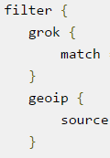
Data Pipeline(II)
File
Top
Packet
Filter
Query
elasticsearch
Where?
Query
Kibana
Input
Filter
Output
Input
Filter
Output
Indexing
Direct
Query
MySQL
Twitter
Redis
MongoDB
Memcache
DNS
ICMP
raw data
grok
json
raw data
log
geoip
add geoip
Zepplin
Customized
UI
Beat
Logstash
Elasticsearch
Spark
Haoop
ordered

Slide 25
Data Pipeline(III)
File
Top
Packet
Filter
Query
elasticsearch
Where?
Query
Kibana
Input
Filter
Output
Buffering
Input
Filter
Output
Indexing
Direct
Query
MySQL
Twitter
Redis
MongoDB
Memcache
DNS
ICMP
raw data
grok
json
raw data
log
geoip
add geoip
Zepplin
Customized
UI
Beat
Kafka
Logstash
Elasticsearch
Spark
Haoop
ordered

Slide 26
Data Pipeline(IV)
Huge buffering of input not to be passed
Entire ES cluster down case, can start where it left off
File
Top
Packet
Filter
Query
elasticsearch
Where?
Query
Kibana
Input
Filter
Output
Input
Filter
Output
Buffering
Indexing
Direct
Query
MySQL
Twitter
Redis
MongoDB
Memcache
DNS
ICMP
raw data
grok
json
raw data
log
geoip
add geoip
Zepplin
Customized
UI
Beat
Logstash
Kafka
Logstash
Elasticsearch
Spark
Haoop
ordered

Slide 27
Index to Document?
(The Structure)
Index (logical namespace)
Data
store
Shard
Sub divided index
Shard
Sub divided index
Type (name + mapping)
: a same data structure for documents
: similar concept of a table
: mapping(database schema) or
schema definition
* It is referenced by ES to know the schema of index by mapping
※ Mapping
(=schema definition=data structure)
describes the fields and properties
that documents of that type may have.
it tells ES how the data in each
document should be indexed
Documents (=JSON Objects)
: data + metadata(info about the document)
Data : just data
Metadata : composed of three elements (index,type, id)
: unique key = idx+type+id or user generated id
queried served

Slide 28
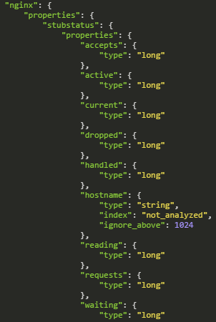
Mapping
Is the process of defining how a document, and the field contains, are stored and indexed
Which string fields should be treated as full text fields
Which fields contain numbers, dates, geolocation
Custom rules to control the mapping for dynamically added fields
template
It is a process to map data to type
Date fields -> dates
Numeric fields -> numbers
String fields -> full-text or exact-value strings
Boolean fields -> Boolean
Floating-point -> float, double
Whole number -> byte, short, integer, long
* reason? : to make elasticsearch know that
what type of data each field contains.
Index
Mapping Types
Meta-fields
_index, _type, _id and _source
each mapping contains, a list of fields or properties
e.g.) user type: title, name, age
blog type: title, body, user_id, created
Fields or Properties
Settings
Text, keyword, date, long, double, Boolean, ip
Object(json) geo_point, geo_shape
String type: could be indexed as a text field for full-text search
Keyword type: for sorting or aggregation
Only string type can be analyzed (standard analyzer)
Index have mapping types
to set how the documents will be indexed
Properties

Slide 29
Mapping (type)
Field | type | description | analyzer
string | text | Full-text search (inverted) | Standard, English, French
 | keyword | Sorting or Aggregation (not inverted)
 | date
 | long
 | double
 | boolean
 | ip
 | json(object, nested)
 | geo_point , geo_shape

Slide 30
What is Analysis?
Combined Processes (Normalization + Tokenization)
※ Purpose: is 1)to make a highly efficient inverted index 2) for making a query precisely
What is normalization? Lowercased word, a word be stemmed, synonyms of word
What is tokenization?
Analysis
normalization
tokenization
By analyzer
Build-in analyzer
standard analyzer (by default) -> Mapping is followed by standard analyzer
simple analyzer
whitespace analyzer
language analyzer
Character filters
Can be combined
to create custom analyzers suitable for different purposes
tokenizers
Token filters

Slide 31
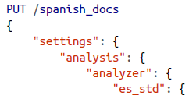
What is Analysis?
(Analyzer)
Analyzer (= is a wrapper that combines three functions into a single package)
Character filters :
Tokenizers: whenever it encounters whitespace, punctuation
token filters: change terms(lowercasing) / add terms / remove terms
Standard analyzer (for full-text fields , it’s a good choice for western languages)
Standard tokenizer
Standard token filter
Lowercase toke filter
Stop token filter (for Korean?...we need to see to support multi language)
Character filter
*Tokenizer
Token filter
It used to tidy up a string before it has tokenized
- [html_strip character filter] to
remove all HTML tags
Tokenizer breaks up the string into individual terms or tokens
Change, add, remove tokens
Lowercase
Stop token filters
Stemming token filters
Asicc folding filter
Ngram
Edge_ngram
Standard | Remove most punctuation
Keyword | the same string as it received
Whitespace | splits text on [whitespace]
pattern | split text on a matching [regular expression]
Edge ngram,letter,lowercase,ngram,thai,etc
Other Analyzers
Standard analyzer (by default) -> Mapping is followed by standard analyzer
Simple analyzer
Whitespace analyzer
Language analyzer
Custom Analyzers

Slide 32
What is Analysis?
(example)
Input value:
Strings
Inverted
Indices
by fields
fulltext
terms
Inverted index
defined analyzer?
- Yes: it will be used
or
- No: standard analyzer by default
In order to be able to treat date fields as dates
Numeric fields as numbers
String fields as full-text
Exact-value strings
So, ES needs to know what type of data each field contained
Define the fields within a type
Datatype for each field
How the field should be handled by ES
Need to see which language
String, date, etc
How?
Mapping

Slide 33
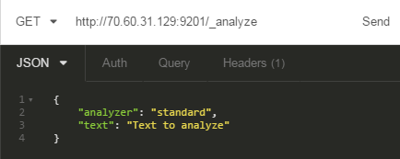
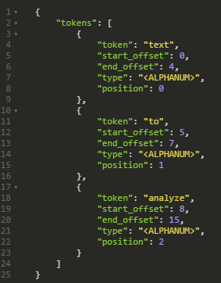
What is Analysis?
(output example by standard)
To better understand what’s going on
Can use analyze API to see how text is analyzed
“standard” is a default analyzer
Automatically configures it as full-text string
Like to interpolate a different type of process with not standard analyzer
It is a “Mapping” <- click

Slide 34
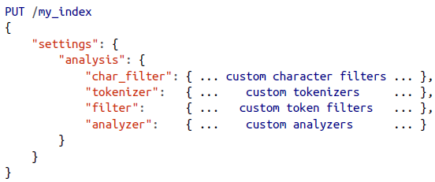
How to use analyzer?
① Create Index with Settings
② Use analyze API for checking that it works correctly
③ Need to tell Elasticsearch where to use it
Apply it to a string field with a mapping like in box #3
Create index
Verify work
Add type & tell to ES
<format>
PUT /my_index
{
}
①
“settings”: {
“analysis”: {
“char_filter”: {
“&_to_and”: {
“type”: “mapping”,
“mappings”: [ “&=> and “]
}
},
“filter”: {
“my_stopwords”: {
“type”: “stop”,
“stopwords”: [ “the”, “a” ]
},
“synonym”: {
“type”: “synonym”,
“synonyms”: [
“albert => albert, al”,
“allan => allan, al”
]
}
},
“analyzer” {
“my_analyzer”: {
“type”: “custom”,
“char_filter”: [“html_strip”, “&_to_and” ],
“tokenizer”: “standard”,
“filter”: [“lowercase”, “my_stopwords”]
}
}
}
②
GET /my_index/_analyze?analyzer=my_analyzer
{
The quick & brown fox
}
③
PUT /my_index/_mapping/my_type
{
“properties”: {
“title”: {
“type”: “string”,
“analyzer”: “my_analyzer”
}
}

Slide 35
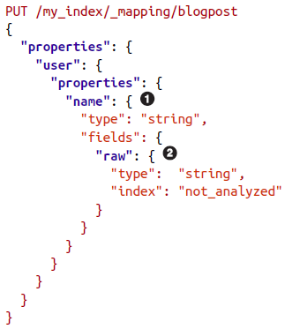
How to use analyzer
(types and mappings)
ES
type (similarly table in DB)
name
Full-text search
mapping
For grouping
Fields
+
Properties
No concept of documents type, mapping
Lucene

Slide 36
When shards?
shards & replicas
An index can potentially store a large amount of data that can exceed the hardware limits of a single node. For example, a single index of a billion documents taking up 1TB of disk space may not fit on the disk of a single node or may be too slow to serve search requests from a single node alone
Left
A single node
It’s time to shard & make replicas
Index
Consumed
What it means
that Index grows?
Can not afford to allocate a free space for storing data
More request as much as the size of data
Index
Shard
(sub divided Index)
Shard
(sub divided Index)
Merits
- High Availability (Redundancy)
- Scale out search volume
- Throughput on all replicas in parallel
※ each index capacity
5 primary shards and 1 replica (10 shards per index)

Slide 37
What is sharding?
Index(ES)
: a collection of shards
Every shard is refreshed automatically once every second
But, also can refresh with refresh API
POST /_refresh
POST /blogs/_refresh
Index
(Lucene)
Shard
Shard
Shard
Memory indexing buffer
Segments
:inverted index
Segments
:inverted index
commit
Segments
:inverted index
document
flush
Filesystem cache (in 1 sec)
Eventually, it will be fsynced.
But, it is a searchable even not synced to disk though
fsync’ed
Filesystem cache
disk
disk
Commit point
Searchable (in 1 min)
* There is a delay between indexing a document and make it be visible

Slide 38
What is sharding?
Index
(Lucene)
Shard
(ES)
Refresh
Not all use cases require a refresh every second.
Able to set an interval for refresh
PUT /my_logs
{
“settings”: {
“refresh_interval”: “30s”
}
}
Can turn off for a big new index and on to enable it
POST /my_logs/_settings { “refresh_interval”: -1 } → diable automatic refreshes (2m(min), 2(millisec))
POST /my_ogs/_settings { “refresh_inverval”: “1s” } → refresh automatically every second
Flush (automatically, every 30 minutes)
POST /blogs/_flush
POST /_flush?wait_for_ongoing

Slide 39
What is sharding?
Index
(Lucene)
Shard
(ES)
For the performance we can use filesystem cache before the index be fsync’ed.
But, where the server reach failure status before commit…we don’t want to lose those either (real time search and data in filesystem cache)
What is the safety belt to secure those situation?
It is a translog or tansaction log, which records every operation in elasticsearch as it happens.
commit
document
indexed
in memory buffer
translog
(X)
(O)
If translog is getting to big?
- The index is flushed
- A new translog is created
- A full commit is performed
and point is written to disk
- The filesystem cache is flushed with an fsync
- The old translog is deleted
- Redo a translog the time after the last commit
Big
Index
disk
Small
pieces
index
Commit point
Index updatable?
Index is an immutable
Use more than one index
Dynamically updatable indices

Slide 40
What is sharding?
Query?
Each inverted index can be queried in turn
→ starting with the oldest and the results combined
A single index (= a collection of shards)
shards
shards
Segment
Segment
Segment
Segment
Inverted index
Inverted index
Inverted index
Inverted index
Time
indexed
Data(=word)
Data(=word)
Data(=word)
Data(=word)
Data(=word)
fsync’ed
fsync’ed
Disk
* Lucene introduced the concept of per-segment search

Slide 41
What is sharding? (index management)
Deletes and Updates
Segment
Segment is immutable, which is cannot be removed from old segments
no can older segments be updated to reflect a newer version of a document
Ever commit point includes a .del file that list which documents in which segments have been deleted.
When a document is “deleted”, it is actually just marged as deleted in the .del file
A document that has been marked as deleted can still match a query,
But, it is removed from the results list before the final query results are returned.

Slide 42
What is sharding? (segment managing)
It’s a backgroud process and happens automatically while indexing and searching
Segment
a big single Segment
Segment
Segment
Segment
Segment
Need to check every segment in turn
Old all *.del will be deleted and does not copied over to the new bigger segment.
And those files are purged from the filesystem.
It happens automatically while indexing and searching
It acts like a process compaction in Cassandra
Tunning is required
query
The more segments there are, the slower the search will be. (performance)
Each segment consumes file handles, memory, and CPU cycles.
So,
ES solves this problem by merging segments in the background.
Small segments are merged into bigger segments.
segments
performance
like a compaction of cassandra

Slide 43
Index management
1. Creating an index
Need to set to customize index
In order not to create index automatically…:
→ action.auto_create_index: false conf/elasticsearch.yml
2. Deleting an index
DELETE /my_index
DELETE /index_one,index_two or /index_*
DELETE /_all
* Index Settings
number_of_shards (number of primary shards-can’t be changed)
number_of_replicas (number of replica shards-can be changed)
3. Configuring Analyzers
Analyzer
4. Re indexing
Settings
mappings

Slide 44
Index management
1. Query
PUT /website <- create a index named “website”
PUT /website/blog/123 { “A”: “va1”, “B”: “val2”} <- id made by owner (version: 1, created: TRUE)
PUT /website/blog/123 { “A”: “val3, “B”: “val4”} <- will be replaced with a new version (version: 2, created: False)
POST /website/blog/ {“ ”: “ ”, “ ”: “ ” } <- will be made by system
GET /website/blog/123?_source=title,text <- can define only two fileds among many
GET /website/blog/123/_source <- can query to receive except for metadata
GET /website/blog/123?pretty <- can receive with the format “JSON”
HEAD /website/blog/123 <- just check whether the document exists (return 200 or 404)
Update API (can be used to make partial update to a document)

Slide 45
Pipeline(logstash)
Three stages for Logstash event processing
inputs → capture stream, turn it into events (generate events)
filters → process events (modify them)
outputs → send events to ship to destination
codecs → input or output filter (i.g, json, multiline)
https://www.elastic.co/guide/en/logstash/5.0/input-plugins.html
https://www.elastic.co/guide/en/logstash/5.0/filter-plugins.html#filter-plugins
grok | Supports 120 patterns
mutate | Transformation (Rename, remove, replace, modify)
drop | Drop debug events
clone | Make a copy of an event
geoip | Add information about geographical location of IP addresses (kibana)

Slide 46
Pipeline
(stitching together multiple input and output)
Logstash
Input
(streams by twitter)
Output 1
elasticsearch
internet
Input
Filter
Output
Output 2
file
Input
(logs by filebeat)
input {
twitter { consumer_key => "enter_your_consumer_key_here"
consumer_secret => "enter_your_secret_here"
keywords => ["cloud"]
oauth_token => "enter_your_access_token_here"
oauth_token_secret => "enter_your_access_token_secret_here"
}
beats { port => "5043" }
}
output {
elasticsearch {
hosts => ["IP Address 1:port1", "IP Address 2:port2"]
}
file {
path => "/path/to/target/file"
}
}
Consuming
-twitter
-beat
filebeat.prospectors:
- input_type: log
paths:
- /var/log/*.log
fields:
type:syslog
output.logstash:
hosts: ["localhost:5043"]
Indexing
-elasticsearch
-file

Slide 47
Query & Filter
What is Query and Filter?
Queries | Filters
relevance | boolean yes/no (=binary question)
Full text (unstructured) | Exact values (structured)
Not cached | Cached
Slower | Faster (dataset->filtered->subset->query)
Filter first, then query remaining docs
Full Dataset
subset
filter
query
GET /_search
{
“query”: {
“filtered”: {
“query”: {“match”: { “title”: “search”}},
“filter”: {“term”: {“status”: “active”}}
}
}
}
Filter (boolean, fast, cacheable)
Kinds | Description | Objects | Examples
Term | Exact values | Dates, Booleans, not_analyzed exact-value string fields | { "term": { "age": 26 }} { "term": { "date": "2014-09-01" }}

Slide 48
Filter (Boolean type)
“bool”: {
“must”: [<filters>], AND
“should”: [filters], OR
“must_not”: [<filters>] NOT
}
{
“filtered”: {
“query”: {“match”: { “title”: “full text search” }},
“filter”; {
“bool”: {
“must”: {“range”: {“created”: {“gte”: “now-1d/d”}}},
“should”: [
{“term”: {“featured”: true}},
{“term”: {“starred”: true}}
],
“must_not”: {“term”: { “deleted”: false}}
}
}

Slide 49
Analytics
Aggregations dsl (domain specific language)
Differen types of aggregations
Buckets | Metrics
Terms | Stats
Date Historgram | Percentile
Filter | Cardinality
Range | Top hits
Nested | Scripted
Children | Max | Min | Avg
 | Simple mathematical operations
Agg = Buckets + Calculated Metric
Buckets : Collection of documents that meet a certain criteria
Metrics : Statistics calculated on the documents in a bucket
Example>
Select count(color)
From table
Group By color
metric
Combining the two is an aggregation
bucket
documents
Designed for speed and scale
Aggregates are computed in-memory
Aggregation can be composed
Near real-time response times
Trades accuracy for speed in some use cases
Single network round-trip
Single pass through the data on shards
Some aggregations are very expensive
Shard Partition
Per Buckets
Sub Buckets
Metric(calc)
Reduce
Results
Parse → Collect & Combine → Reduce

Slide 50
Modeling Your Data
How to fill up the gap between FlatWorld and RealWorld(RDB)
Application-side joins
Data denormalization
Nested objects: all entities live within the same document
Parent/child relationships: completely separate documents

Slide 51
Beats
Examples of operational data
Wired data
System stats
Logs
Packetbeat
Topbeat
Filebeat
Winlogbeat
Captures insights from
Network packets
-Copy traffic at OS or hardware level
-Is completely passive
-ZERO latency overhead
-Not in the request/response path,
Cannot break your application
Like the Unix top command but
Sends the output periodically to
Elasticsearch. Also works on windows
System wide (system load, cpu(core),memory
Per process: state name command line pid
Disk usage: used , free, mounted points
Like Forwards log lines to Elasticsearch
Client
sniff
Use cases
Security (Intrusion Detection)
Troubleshotting network issues
Troubleshotting applications
Performance analysis
Server

Slide 52
Beats-packetbeat
1
2
3
4
5
Capture network
traffic
Decodes network
traffic
Corelates request
With response
in transactions
Extract
Measurements like
Response time,
status
Group meta info
Json objects
to send to elasticsearch
It does all of these in real-time directly on the target servers
HTTP | Thrift-RPC | DNS | (+) addable
MySQL | Memcache | AMQP
PostgreSQL | MongoDB | Redis | ICMP

Slide 53
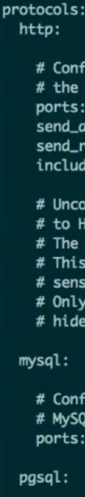
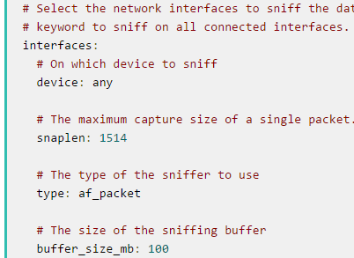
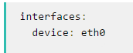
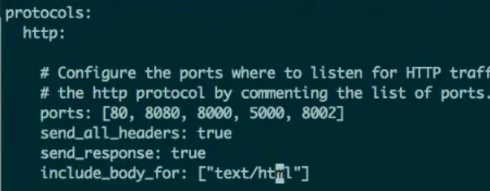
Beats-packetbeat
Network devices | Packetbeat.interfaces.device: any * Select the network interface to sniff the data Any means all connected interfaces
Transaction protocols | Packetbeat.protocols.icmp [amqp, dns,http,memcache,mysql,pgsql,redis,mongodb,nfs] Port and types to listen
Output | ES output LS output

Slide 54
Beats-filebeat
Never lose a log line
Logstash
can request to slow down its rate
(the speed of streaming To Filebeat)
- Filebeat sends out unparsed log lines
- Use filters from Logstash to parse the log lines
- Flexible, with conditionals & custom filters
- Forward data to other systems using the Logstash output plugins
- Multiline features
Who parse it?
Two options:
1. via Logstash (filtering grok, mutate, etc(combine)) or
Write my filter in Ruby
2. Ingest Node (= not through Logstash) ,Upcoming in 5.0
* It supports multiline process
Back-pressure
Sensitive
protocol
Filebeat
(log forwarder)
Read pointer
syslog
line
line
Pointer(registry)
line
The original log line act like a queue
line

Slide 55
Beats-filebeat
Never lose a log line
Back pressure
Filebeat
Logstash
To send the data to Redis/Kafka
Redis / Kafka
Module
-Apache2
-Auditd
-icinga
-Kafka
-Logstash
-MySQL
-Nginx
-Osquery
-PostgreSQL
-Redis
-System
-Traefik
To enrich and transport data securly
Logstash
Elasticsearch
redesign
Filebeat
Redis / Kafka
Logstash
Elasticsearch

Slide 56
Beats-metricbeat
To provide common infrastructure for all “metrics” related Beats
A module for each monitored system
1
2
3
Groups performance data into documents
Periodically polls monitoring APIs
Of various services
Ship them to logstash, elasticsearch
Apache
MySQL
Redis
Golang
Same code same functionality => Matricbeats comes out
Metricbeat
libbeat

Slide 57
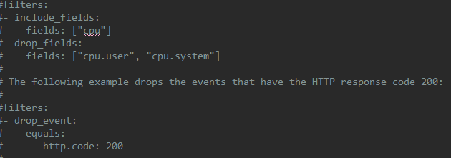
Beats-topbeat
Configuration management
Logging
Demonizing
Windows service handling
Data processing module(future) filtering/sampling
Implemented in “libbeat”
Collector
What?
→ Data
Publisher
L.G
Input
Event
Output
E.S
→ output
xxx.beat.template.json
(index format)
※ each beat use template for output
: /Topbeat options/General options/Filters(rule)/Output
topbeat.template.json
Packetbeat.template.json
※ be able to define many option at filters
in xxxbeat.yml file
include_filelds:
drop_fileds:
Drop event http.code=200

Slide 58
Beats-community beats
Apachebeat | Dockerbeat (per container) | Elasticbeat | Execbeat
Factbeat | Hsbeat | Httpbeat | Nagioscheckbeat
Nginxbeat | Phpfpmbeat | Pingbeat | Redisbeat
Unifiedbeat | Uwsgibeat

Slide 59
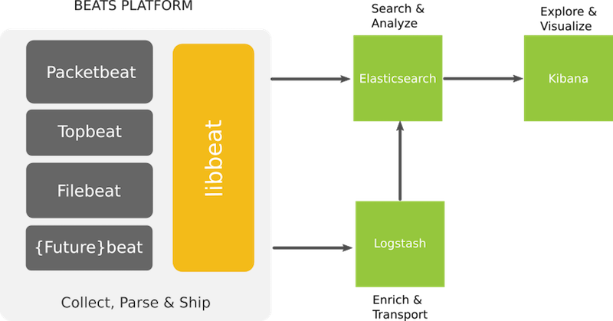
Beats
Lightweight shippers for Elasticsearch & Logstash
Periodically ships system-wide and Per-process statistics from servers
Folder | Description
libbeat | The Go framework for creating new Beats | Officially supported by ES
Topbeat | Like 'top' but inserting the data into Elasticsearch
Packetbeat | Tap into your wire data
Filebeat | Lightweight log forwarder to Logstash & Elasticsearch
Winlogbeat | Sends Windows Event logs
Install an agent on servers, which collecting of data is required
Ships log files from servers
Community Beats
apachebeat / dockerbeat /
jmxproxybeat /
imsensorbeat (linux sensor, cpu temp, fan speeds, voltages) /
mysqlbeat / nginxbeat /
redisbeat / twitterbeat /
udpbeat / pingbeat /
nagioscheckbeat / execbeat(shell cmds)

Slide 60
Beats
ELK stack setup has four main components:
Logstash: The server component of Logstash that processes incoming logs
Elasticsearch: Stores all of the logs
Kibana: Web interface for searching and visualizing logs, which will be proxied through Nginx
Beat: Installed on client servers that will send their logs to Logstash, Serves as a log shipping agent that utilizes Packetbeat, Topbeat, and Filebeat are a few examples of Beats
Client Servers
Web Server
Beat
(File)
ELK STAK/ LOGSTASH SERVERS
Beat
(Http)
Logstash Elasticsearch Kibana
Client
DB Server
Beat
Process
&
Transport Logs
Index &
Store Logs
Search
&
Visualize Logs
Ship Logs

Slide 61

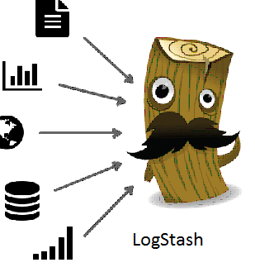


Beat - Packetbeat
Sniffs the traffic between your servers, parses the application-level protocols on the fly, and correlates the messages into transactions.
For each transaction, Packetbeat inserts a JSON document into Elasticsearch which can be further visualize in Kibana.
Sniffs traffic
PacketBeat
Correlates messages to transaction
Visualize
Sniffs traffic
Notes:
Live Demo of packet beat http://demo.elastic.co/packetbeat/

Slide 62
Beat - Packetbeat
A real-time network packet analyzer that you can use with Elasticsearch to provide an application monitoring and performance analytics system.
Works by capturing the network traffic between your application servers, decoding the application layer protocols (HTTP, MySQL, Redis, and so on) correlating the requests with the responses, and recording the interesting *fields for each transaction.
Packetbeat can help you easily notice issues with your back-end application, such as bugs or performance problems, and it makes troubleshooting them - and therefore fixing them - much faster.
Supported protocols from packetbeat
ICMP (v4 and v6)
DNS
HTTP
AMQP 0.9.1
Mysql
PostgreSQL
Redis
Thrift-RPC
MongoDB
Memcache
*- Refer Appendix
Notes:
Live Demo of packet beat http://demo.elastic.co/packetbeat/

Slide 63
Beat - Packetbeat
/etc/packetbeat/packetbeat.yml file is the main config file that keep the information about interface, protocols and ports for capturing the transactions. Also includes configuration to send data after capturing and processing.
Two ways to deploy:
On dedicated servers, getting the traffic from mirror ports or tap devices. Less overhead on application servers, but requires dedicated networking gear
On existing application servers.
Packetbeat has several options for traffic capturing:
pcap, which uses the libpcap library and works on most platforms, but it’s not the fastest option.
af_packet, which uses memory mapped sniffing. This option is faster than libpcap and doesn’t require a kernel module, but it’s Linux-specific. Optimal sniffing mode for both deployment options
pf_ring, which makes use of an ntop.org project. This setting provides the best sniffing speed, but it requires a kernel module, and it’s Linux-specific. Sniffing speed of Gigabits/s for dedicated servers for packetbeat.
Notes:
Live Demo of packet beat http://demo.elastic.co/packetbeat/

Slide 64
Beat - Packetbeat
To configure Packetbeat, edit the /etc/packetbeat/packetbeat.yml
Select the network interface from which to capture the traffic.
In the protocols section, configure the ports on which Packetbeat can find each protocol. If you use any non-standard ports, add them here.
Set the IP address and port where Packetbeat can find the Elasticsearch installation:
Notes:
Live Demo of packet beat http://demo.elastic.co/packetbeat/

Slide 65
Beat - Packetbeat
Packetbeat is Go program, The current Go version used for development is Golang 1.6.2. Packetbeat use a variety of scripts based on python to generate configuration files and documentations.
The way Packetbeat works is that both the kernel and the user space program map the same memory zone, and a simple circular buffer is organized in this memory zone. The kernel writes packets into the circular buffer, and the user space program reads from it. The poll system call is used for getting a notification for the first packet available, but the remaining available packets can be simply read via memory access.
Example:
packetbeat.interfaces:
device: eth0
type: af_packet
buffer_size_mb: 100
Packetbeat’s source code is split up in Go packages or modules.
The protocol modules can be found in individual folders in the beats/packetbeat/protos directory of
https://github.com/elastic/beats/tree/master/packetbeat
At the high level, the protocols plugins receive raw packet data via the Parse() or ParseUdp() methods and produce objects that will be indexed into Elasticsearch. Parse() get called for every packets captured.
Notes:
Live Demo of packet beat http://demo.elastic.co/packetbeat/

Slide 66
Beat - Packetbeat
Input packet
type Packet struct {
Ts time.Time (1)
Tuple common.IpPortTuple (2)
Payload []byte (3)
}
Output packet
The JSON like objects are sent using the publisher.Client interface defined in the
beats/libbeat/publisher
Protocol Module
beats/packetbeat/protos/protos.go
Parse() / ParseUdp()
TcpProtocolPlugin
implements
UdpProtocolPlugin
MySQL module
HTTP module
etc module
DNS
module
etc
module
Notes:
Live Demo of packet beat http://demo.elastic.co/packetbeat/

Slide 67
Use-cases
Type of Resources | Description
File | * Internal Systems Host/Event logs (e.g. Windows, Linux, Server, Switch, Storage) Tracking new behavior of users requests (e.g. app generated log) Measuring of customer response Near Real Time Tracking of Events (Who tries to open my admin page) Malicious behavior (Security, Fraudulent activity) Anti-virus logs Forensics on the machine Investigation Backend Information Factory NRE on-demand interactive data mining System resource monitoring (e.g. Storage Volume Usage) Web farm health check (e.g. Cellwe)
Process | * System process (ex: top process-Mem,CPU) be able to integrated with monitoring system
Packet | * Network protocol (currently, HTTP)
Analytics | * Connect speedy search with Big Data Analytics can be packaged & integrated with system for analytics

Slide 68
Logstash
beats
Logstash
* transformation
elasticsearch
Performaing Core operation | Filter (date, drop, fingerprint, mutate, ruby)
Deserializaing Data | Codec (avro, csv, fluent, json, protobuf, xml,
Extracting Fields and Wrangling data | Filter (dissect, kv, grok)
Enriching Data with lookup | Filter (dns , elasticsearch, geoip, jdbc_static, jdbc_streaming, translate, useragent)
S3
HDFS

Slide 69
Logstash
beats
logstash
elasticsearch
Over 200 plugins
What? : transforming while processing data
- core operation
- Deserializing Data (deserializing data to logstash events)
- Extracting Fields and Wrangling Data
*back-pressure
filebeat
winlogbeat
Filter
Date filter
Drop filter
Fingerprint filter
Mutate filter (rename, replace, modify(strip))
Avro
Csv
Fluent
Json
Protobuf
Dissect filter
KV filter
Grok filter
: syslog, apache & other webserver logs, mysql log, etc)
S3
persistentqueue
HDFS

Slide 70
Use-cases
Application Monitoring
Get notified when:
• App response time exceeds SLA
• # of active users spikes or plummets
• User activity drops in a specific geo
Real-Time Tracing
• Issue and errors or events
External Interfacing
• Monitoring module as a service
IP Operational Analytics
Get notified when:
• 404 errors > 100 in last 5 minutes
• Free disk space drops below 5%
Security Analytics
Get notified when:
• > 5 failed logins from same IP in 15 min
• Unknown process consumes a large amount of memory
• Anomalous outbound data transfer
Root Cause Analysis
• Why are certain nodes not responding?
• Why is my cluster not ingesting more data?
• Why is one node busier than the others?
Optimization and Capacity Planning
Is my current usage healthy?
• What is the growth rate in ingestion,
search, total docs, or memory usage?
• How many nodes will I need in 6 months?
• What’s the impact of my application change?
Behavior Analysis
What other endpoints did a known
malicious IP also visit?

Slide 71
Who use this stack?
LinkedIn
More than 30 ELK clusters (across multiple DCs)
Cluster with 50+ billion docs (50+TB) each
Daily indices average 3+ billion docs, 3+TB
15,000 indices
~1,000 shards per cluster
Wikipedia
Uses Elasticsearch to provide full-text search with highlighted search Snippets.
GitHub
GitHub uses Elasticsearch to query 130 billion lines of code.
E-bay

Slide 72
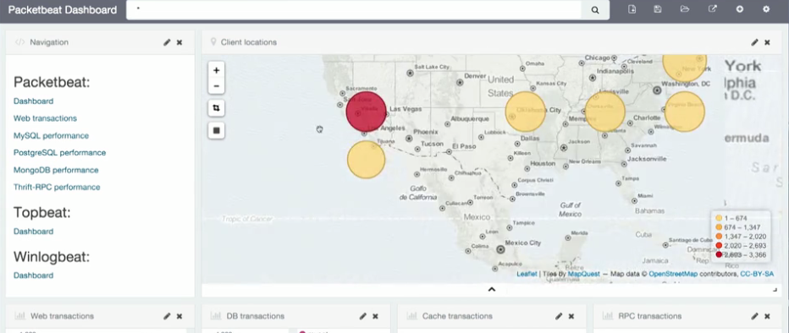
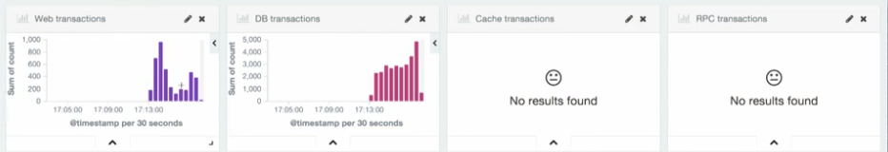
Example Screen

Slide 73
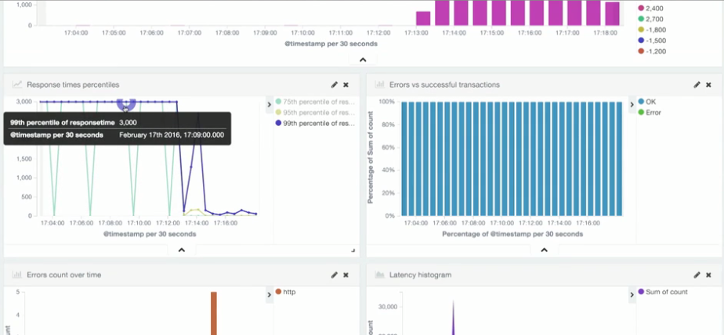
Example Screen

Slide 74
Attachments
I. Basic Model
II. Mid-Scale Model
Collection
Store
View
대량메시지수집시
큐활용 모델
III. Large Scale or
Multi Region
Support Model

Slide 75
Master election
discovery.zen.ping_timeout: 3
No failure on master, but network is slow..then increase this number
How the role be given?
master
data node
ingest
coordinator
node.master | true or false
node.data | false or true
1sec
1sec
1sec
Master election begins

Slide 76
Fault detection
master
other nodes
Ping from master to the others
Verify still alive
Verify still alive
Ping from the others to master
If we enable
: discovery.zen.fd.(ping_interval, ping_timeout, ping_retries)

Slide 77
Who’s goanna update cluster status?
other nodes
master
other nodes
other nodes
applies the required changes and publishes the updated cluster state
other nodes
Queue1
Queue2
Queue3
Queue4
…
publish
respond
commit
apply

Slide 78
Important system settings
Setting | What
JVM heap size | Set the minimum heap size (Xms) and maximum heap size (Xmx) to be equal to each other Set Xmx to no more than 50% of your physical RAM More memory = more caching but, garbage collection pause
Disable swapping | sudo swapoff –a sysctl value vm.swappiness is set to 1
Increase file descriptor | set ulimit -n 65536 as root before starting Elasticsearch, or set nofile to 65536 in /etc/security/limits.conf
Sufficient virtual memory | sysctl -w vm.max_map_count=262144 update the vm.max_map_count setting in /etc/sysctl.conf
Sufficient thread | nproc to 4096
https://www.elastic.co/guide/en/elasticsearch/reference/6.1/bootstrap-checks.html

Slide 79
Attachments

Slide 80
DR/HA
Index/query
Cluster
M
A
S
T
E
R
Datanodes (Real1)
Datanodes (Real2)
snapshot
Recovery/
ReIndex
Queue
Storage
Pipeline from each sources

Slide 81
Hot/Warm Architecture
Tag the Nodes
Configure the Hot Data on each Index
Interval
Move Older Shards to Warm
node.attr.my_node_type:hot
index.routing.allocation.require.my_node_type:hot
1 month later
Index.routing.allocation.require.my_node_type:warm

Slide 82
Queue
Beat
Logstash
Elasticsearch
output
input
input
queue
filter
output
Persistent
queue
* For output
- buffering &
- combining event
dead_letter_queue.enable: true
path.dead_letter_queue: “path/to/data”
Metricbeat
(internal queue
Memory}
Limitation of Persistent Queue
beat, http support
No replication, not handle disk failure
All
event
Dead letter queue
Only output
400,404 or
mapping error
Can’t be retried

Slide 83
Logstash pipeline
Input
Tcp
JDBC
Beat
File (file read & file close, sincedbnew line every end of line
Codec, character-set)
filter
Grok (can add tag)
multiline
Output
message
Message + alpha

Slide 84
Logstash stages for a scalability
AS…
The role of logstash
Shipper
Data received to a Kafka topic
Does not do much processing
Indexer
Consume data
Expensive transformations
Grok,
DNS lookup,
Indexing into Elasticsearch

Slide 85
Index
Lucene instance
lucene index
a collection of segments
Never updated
Index
Segment
(inverted index)
shard
shard
file
disk
file
file
shard
file
segment
disk
Index(write, query, delete)
segment
disk
Segment
BKD trees
Normalization
factors
doc_values
Column-oriented
fashion
Sort, Aggregation
Not analyzed
deleted documents
stored filed values
Term dictionary and frequency
Bit set
_source
document
word
document
document
Inverted Index

Slide 86
Refresh & Fresh
Transaction Log
OS
(kernel file object)
Media
memory buffer
data analyzed
memory shared by all shards
segments
Data
write
Disk
fsyncd
create a new segment
Finally, data is shown
merged
no
buffer full?
yes
flush
refresh interval : every second
*Every Second?
-Pros: It gives a query performance issue (i.g: 5s > 1s, 30%)
-Cons: can search right after input
Refresh?
commit
lucene
flush
elasticsearch

Slide 87
Cluster Level Shard Allocation
When does it happens?
Replica allocation
Rebalancing
Nodes are added or removed
Initial recovery
Cluster level | shard allocation settings | Allocation & Recovery
 | shard rebalancing settings | To control Rebalancing of shards across the cluster
 | shard balancing heuristics | Extra supplement options ,which can be used.
Disk level | Shard allocate or relocate | Watermark
Allocation Awareness |  | disk, hosts, network, switch, rack
Shard allocation filtering |  | Include, require, exclude
*balancing algorithm

Slide 88
Shard & Segment
Reindex? When
Primary & Replica
performance
Unlimited?
Size of segment
size of
shared
20~50GB
overhead
the point of
unupdatable index
The size is predictable
:time-based data
shards
forcemerge
forcemerge
forcemerge
Last forcemerge
- #Shard(20~25)/Heap(1GB)
- #700 Shards => 32GB Node
- 1.4TB Disk (then, we need to think….4TB, 8TB, 16TB?)

Slide 89
Doc Values
What Benefit?
Smaller Heap (it does not use JVM Heap)
Smaller Garbage Collection
Finally, Same performance
(X)It’s a trick not to make it resides on JVM(heap)
(O) Cached onto OS’ Mem
Performance (can use memory, even it is stored into memory)
Scalability (leverage Disk’s swap feature)
Doc Values
(a structure on disk
Column oriented fashion)
Only work on exact value fields
Not analyzed fields
OS’Mem
(32GB)
JVM
(32G)
Disk
Mem(64GB)
OS
Note)
Doc Values (why doc values come out? ) vs. Inverted Index
uninvert the inverted index good for searching
@_search time but, some action(sorting)
go into heap? it has to be uninvert
=> Run out of memory then go into out of memory lots of memory be used
Once,
field(‘text’) has to be analyzed..so that reason, there is no doc values
field(‘keyword’) has doc values. so, it is good for sorting and aggregating

Slide 90
Index & Template
Pattern of the
index naming
(name)
Index
Injected
once at an index
creation time
Template
Settings # of shards
analysis
Mappings
dynamic_template
properties
- fields)
data
Dynamic
template
Scheme
Raw Data
(Various Logs)

Slide 91
ES & Java heap
Why heap does not recommended more than 32GB?
JVM handle heap memory where is a living place of objects.
2^32 = 4GB memory (max), if mem over > 4GB? Then it use COOP
2^64 = 18EB (more memory, more computation)
address
Object
Address to access object in memory
Object
Ordinary
Object
Pointer
Object
Object
address
Heap memory
In genera, OOP used
If (heap)object size > 4GB, then COOP be used
If (heap)object size > 32GB, the 64bit OOP be used
Compressed ordinary object object)
For this reason, 32GB heap is recommended
Too much small > OOM
Too much big > Garbage Collection
JVM

Slide 92
ES & Java heap
Too Small | Too Large
Reduced throughput from constant garbage collection pauses Reduce the number of operations Constant short pauses -> reduce the number of indexing operations and queries per second Reduce the memory available for indexing buffers, caches, memory-hungry features like aggregations and suggesters | Long latency spikes from full-heap garbage collections User requests will sometimes see unacceptably-long response times. Long pause is indistinguishable from node that is un reachable because it is hung or isolated from the cluster. No code executing(no read, write) Long garbage collection pause no-master -> master election Reallocating the paused node’s assigned shards. -> increase network traffic , increase disk I/O Finally, instability

Slide 93
ES & Java heap
Use half of the total memory or a little bit lesser
Assign 32GB Memory force to use Compressed OOP, pl, check the limit and possibility fo COOP
>java –Xmx32766m –XX:+PrintFlagsFinal 2>/dev/null | grep UseCompressedOops
Check the memory be able to started from Zero Based
JVM store address of each objects to be structured OOP. (max 4GB of 32bits)
There is another concept called COOP(Compressed Ordinary Objects Pointer), which is memory points to address objects where in Heap memory to extend the addressing.
Can extends address thru COOP 8 times bigger than general OOP
So,
Recommended not to use 64bit
OOP | 4GB pointer
COOP | Capability32GB
5GB-~32GBMem
COOP
OOP
4GB Mem
Max address

Slide 94
What goes on Heap Memory?
Heap
ClusterState
The status of cluster
FieldData cache
_source
(holds the field value,
use this cache while computing aggregation)
IndexWriter
Writing Index (newly indexed docs)
Node Query/Filter Cache
If a doc matches a filter context
(shared by all shards)
Shard Request Cache
Caches results of query by each shard
Global result set
Shard level
local result
Shard
Local result
Local result
shard
Local result
shard

Slide 95
Performance tunning
Indexing Buffer | Default to 10% of the node heap (i.g, 2GB of 16GB Heap), is shared by all shard * indices.memory.index_buffer_size: 5%

Slide 96
Hardware Recommendations
Items | Spec | Description
Box | X86 | General X86 boxes
CPU | 2 ~ 8 cores 32cores (production) | Modern processor Choose more cores than faster CPUs
Mem | Min: 16GB Best: 32GB Ideal: 64GB More sorting and aggregation? 64GB | 8GB memory does not recommended Do not over 32GB for Java Heap Give half your memory to Lucene ElasticSearch 32GB, Rest of other Lucene
Disks | SSD (still question? How many disks/node) Size : 2TB | To improve query and indexing performance Pl, check disk I/O scheduler cfq is used by default. It is efficient to support spindle disk. But not for SSD. No recommendation Network attached storage http://www.mimul.com/pebble/default/2012/05/12/1336793032150.html
Network | Bandwidth(10GbE) | Do not cluster across data centers even if the DCs are colocated
32(ES) | Rest(Lucene)
cfq | spinning disk
deadline | SSD | Raid0 DBMS
noop | SSD

Slide 97
Role of Nodes
Node Type | Role | Description | Options
Master |  |  | node.master: true node.data: false node.ingest: false node.ml: false xpack.ml.enabled: true
Data |  |  | node.master: false node.data: true node.ingest: false node.ml: false
Ingest | Pre-process documents before actual document | 1. define pipeline pipeline-> specifies a series of processors description processors blablabla processors blablabla | node.master: false node.data: false node.ingest: true search.remote.connect: false node.ml: false
Logstash
Kibana
Machine Learning |  |  | node.master: false node.data: false node.ingest: false search.remote.connect: false node.ml: true xpack.ml.enabled: true
Coordinating |  |  | node.master: false node.data: false node.ingest: false search.remote.connect: false node.ml: false

Slide 98
Bulk
Log events
Elasticsearch
Queue
Create
Index
Update
Delete
200?400
BULK
operation

Slide 99
Query Structures
“query”
“match”
“term”
“bool”
“multi_match”
“range”
“wildcard”
“regexp”
“exists”
“nested”
“must”
“match”
“match”, “match”
“must_not”
“range”
“exists”
“should”
“multi_match”
“query”,
“field”,
“operator”
“query”
“filter”
“script”
“match”
,
“match”
“aggs”
“sort”
script
(painless)
Scriptfields

Slide 100
Query Structures
“query”
“match”
“term”
“bool”
“multi_match”
“range”
“wildcard”
“regexp”
“exists”
“nested”
“must”
“match”
“match”, “match”
“must_not”
“range”
“exists”
“should”
“multi_match”
“query”
“query”,
“field”,
“operator”
“filter”
“script”
“match”
,
“match”
“aggs”
“bucket”
(range, terms)
“metrics”
(sum, min, max, stats, cardinality)
“Combining (bucket + metric)”
“range + avg)
“date_range”
Buckets(“terms”)
The result of terms agg does not exactly accurate cause the result from shards be backed by top of each shards which means some data from a shard does not be returned even the value has high than other value of different shard

Slide 101
Coordinating node
result
Data
node
Data
node
Data
node
Data
node
(I) scatter phase
(II) gather phase
Coordinating node
result
result
result
result
result
requests
response

Slide 102
Sizing
CPU | Heavy indexing Complex analysis chains ES scripting Logstash filters
Memory | Sorting large datasets Complex aggregations
Disk I/O | Heavy indexing loads Logstash file input Logstash file output Lucene merges

Slide 103
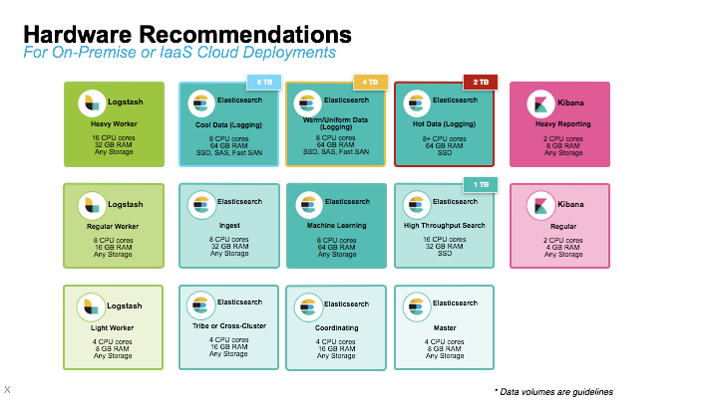
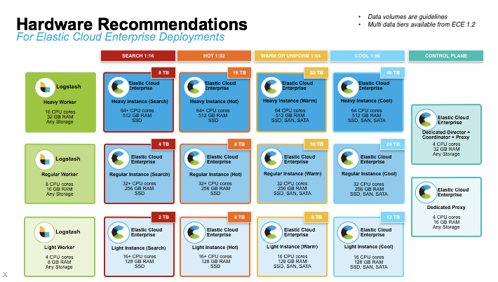

Slide 104
Use cases
1) Coinbase
Peak Index Volume
912,739,256 documents/hr (1.1T)
Peak Search Volume
1,500 queries/s
Reliability is critical
I3.4xlarge
(122GB, 32CPU, 3.8TB)
c4.2xlarge
(15GB, 8CPU, 3.8TB)
Coordinating nodes
Hot
Master nodes
node
node
node
Kibana
ELB
node
node
node
node
Warm
node
node
t4.2xlarge
61GB, 8CPU)
M4.4xlarge
(61GB, 16CPU, 10TB)

Slide 105
Use cases
2) Synthesio
136TB => reindex
What type of cluster to form it?
Cluster (type1)
Cluster (type2)-opted
CPU: 12Core
Mem: 512GB
Disk: 9*800GB(SSD)
CPU: 12Core
Mem: 512GB
Disk: 9*800GB(SSD)
CPU: 12Core
Mem: 512GB
Disk: 9*800GB(SSD)
CPU: 12Core
Mem: 512GB
Disk: 9*800GB(SSD)
CPU: 4Core
Mem: 64GB
Disk: 800GB(SSD)
CPU: 4Core
Mem: 64GB
Disk: 800GB(SSD)
CPU: 4Core
Mem: 64GB
Disk: 800GB(SSD)
CPU: 4Core
Mem: 64GB
Disk: 800GB(SSD)
CPU: 4Core
Mem: 64GB
Disk: 800GB(SSD)
CPU: 4Core
Mem: 64GB
Disk: 800GB(SSD)
CPU: 4Core
Mem: 64GB
Disk: 800GB(SSD)
CPU: 4Core
Mem: 64GB
Disk: 800GB(SSD)
Scalable much easier
75 physical machines are running

Slide 106
Use cases
Deployment architecture at Synthesio
CPU: Quad Xeon D-1521 2.40GHz
Mem: 64GB
Disk: 4*800GB(SSD) – RAID-0
Filesystem: XFS
Total Storage Size: 218,75TB
4,68TB Memory
(2.39 TB Heap memory)
HAproxy(query)
Admin operation
DC1
DC2
DC3
Coordinator1
Coordinator2
Master1
Master2
Master3
…
Data35
…
Data70
Data1
Data36

Slide 107
What is Routing?
Routing = which shard? = hash(document id) % number_of_primary_shards
Shard 0
Shard 1
Documents
Documents
Documents
Documents
Master
Put?route=XXXX
Shard 2
i.g: Hash(XXXX)/5
Number => 4
Shard 3
Shard 4

